Slide 1


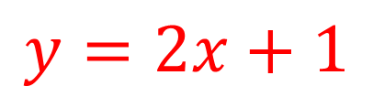
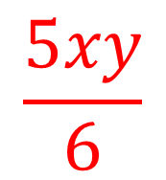
My Algebra
Interactive Notebook
$$\frac{5xy}{6}$$
$$3ab$$
$$2x+3y$$
$$y=2x+1$$
Name
Class
Term 3 Semester 2

Slide 2
Contents
Page
Date
Description
2
3

Slide 3
Tasks
24
7
30
Essential Question
Questions
Notes
Summary
4
5

Slide 4
24
7
30
Date
Expanding Brackets
EQ – How do I use the distributive law to expand brackets?
5

Slide 5
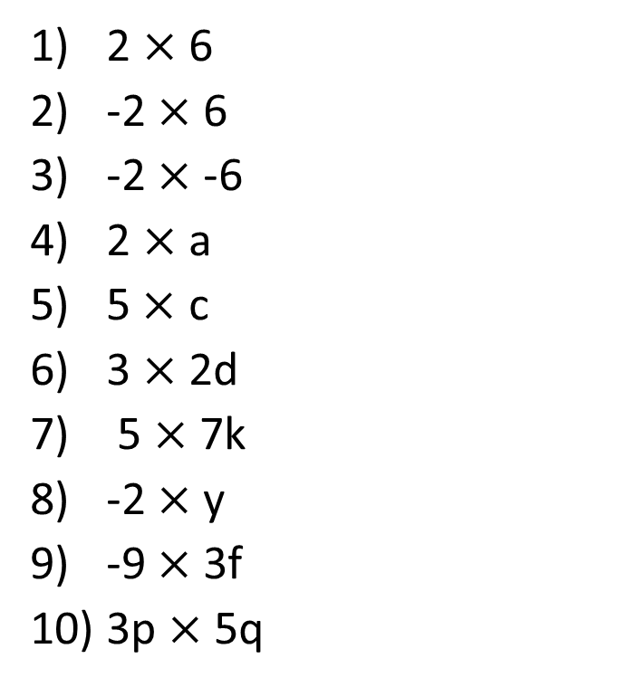
Simplify
2 $×$ 6
-2 $×$ 6
-2 $×$ -6
2 $×$ a
5$×$ c
3 $×$2d
5 $×$ 7k
-2 $×$ y
-9 $×$ 3f
3p $×$ 5q

Slide 6
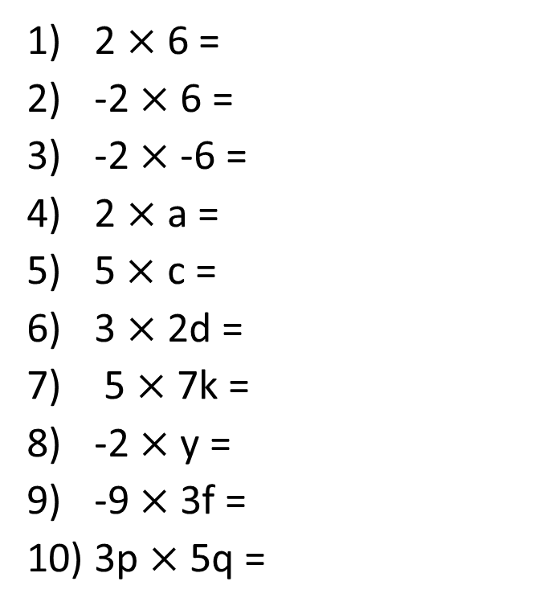
Simplify
2 $×$ 6 =
-2 $×$ 6 =
-2 $×$ -6 =
2 $×$ a =
5$×$ c =
3 $×$2d =
5 $×$ 7k =
-2 $×$ y =
-9 $×$ 3f =
3p $×$ 5q =
12

Slide 7
Simplify
2 $×$ 6 =
-2 $×$ 6 =
-2 $×$ -6 =
2 $×$ a =
5$×$ c =
3 $×$2d =
5 $×$ 7k =
-2 $×$ y =
-9 $×$ 3f =
3p $×$ 5q =
12
-12

Slide 8
Simplify
2 $×$ 6 =
-2 $×$ 6 =
-2 $×$ -6 =
2 $×$ a =
5$×$ c =
3 $×$2d =
5 $×$ 7k =
-2 $×$ y =
-9 $×$ 3f =
3p $×$ 5q =
12
-12
12

Slide 9
Simplify
2 $×$ 6 =
-2 $×$ 6 =
-2 $×$ -6 =
2 $×$ a =
5$×$ c =
3 $×$2d =
5 $×$ 7k =
-2 $×$ y =
-9 $×$ 3f =
3p $×$ 5q =
12
-12
12
2a

Slide 10
Simplify
2 $×$ 6 =
-2 $×$ 6 =
-2 $×$ -6 =
2 $×$ a =
5$×$ c =
3 $×$2d =
5 $×$ 7k =
-2 $×$ y =
-9 $×$ 3f =
3p $×$ 5q =
12
-12
12
2a
5c

Slide 11
Simplify
2 $×$ 6 =
-2 $×$ 6 =
-2 $×$ -6 =
2 $×$ a =
5$×$ c =
3 $×$2d =
5 $×$ 7k =
-2 $×$ y =
-9 $×$ 3f =
3p $×$ 5q =
12
-12
12
2a
5c
6d

Slide 12
Simplify
2 $×$ 6 =
-2 $×$ 6 =
-2 $×$ -6 =
2 $×$ a =
5$×$ c =
3 $×$2d =
5 $×$ 7k =
-2 $×$ y =
-9 $×$ 3f =
3p $×$ 5q =
12
-12
12
2a
5c
6d
35k

Slide 13
Simplify
2 $×$ 6 =
-2 $×$ 6 =
-2 $×$ -6 =
2 $×$ a =
5$×$ c =
3 $×$2d =
5 $×$ 7k =
-2 $×$ y =
-9 $×$ 3f =
3p $×$ 5q =
12
-12
12
2a
5c
6d
35k
-2y

Slide 14
Simplify
2 $×$ 6 =
-2 $×$ 6 =
-2 $×$ -6 =
2 $×$ a =
5$×$ c =
3 $×$2d =
5 $×$ 7k =
-2 $×$ y =
-9 $×$ 3f =
3p $×$ 5q =
12
-12
12
2a
5c
6d
35k
-2y
- 27f

Slide 15
Simplify
2 $×$ 6 =
-2 $×$ 6 =
-2 $×$ -6 =
2 $×$ a =
5$×$ c =
3 $×$2d =
5 $×$ 7k =
-2 $×$ y =
-9 $×$ 3f =
3p $×$ 5q =
12
-12
12
2a
5c
6d
35k
-2y
27f
15pq

Slide 16
24
7
30
Date
Expanding Brackets
EQ – How do I use the distributive law to expand brackets?
To expand brackets you are finding an equivalent expression without the brackets
5

Slide 17

24
7
30
Date
Expanding Brackets
EQ – How do I use the distributive law to expand brackets?
To expand brackets you are finding an equivalent expression without the brackets
$3(x+5)$ without the brackets is $3x+15$
5

Slide 18

24
7
30
Date
Expanding Brackets
EQ – How do I use the distributive law to expand brackets?
To expand brackets you are finding an equivalent expression without the brackets
$3(x+5)$ without the brackets is $3x+15$
$$3\left(x+5\right) means 3×(x+5)$$
5

Slide 19
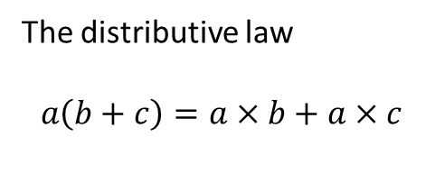
24
7
30
Date
Expanding Brackets
EQ – How do I use the distributive law to expand brackets?
To expand brackets you are finding an equivalent expression without the brackets
$3(x+5)$ without the brackets is $3x+15$
Everything on the inside gets multiplied by the number on the outside
$$3\left(x+5\right) means 3×(x+5)$$
The distributive law
$$a\left(b+c\right)=a×b+a×c$$
5

Slide 20
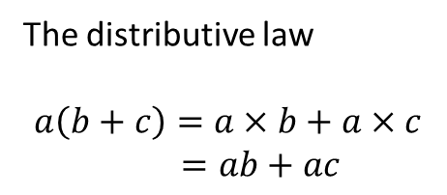
24
7
30
Date
Expanding Brackets
EQ – How do I use the distributive law to expand brackets?
To expand brackets you are finding an equivalent expression without the brackets
$3(x+5)$ without the brackets is $3x+15$
Everything on the inside gets multiplied by the number on the outside
$$3\left(x+5\right) means 3×(x+5)$$
The distributive law
$$a\left(b+c\right)=a×b+a×c$$
$=ab+ac$
5

Slide 21
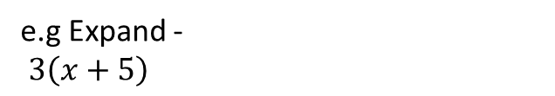
24
7
30
Date
Expanding Brackets
EQ – How do I use the distributive law to expand brackets?
To expand brackets you are finding an equivalent expression without the brackets
$3(x+5)$ without the brackets is $3x+15$
Everything on the inside gets multiplied by the number on the outside
$$3\left(x+5\right) means 3×(x+5)$$
The distributive law
$$a\left(b+c\right)=a×b+a×c$$
$=ab+ac$
e.g Expand -
$3\left(x+5\right)$
5

Slide 22
Fill in the questions

Slide 23
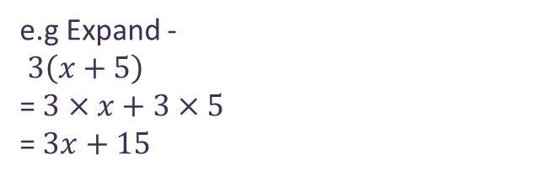
24
7
30
Date
Expanding Brackets
EQ – How do I use the distributive law to expand brackets?
What does expanding brackets mean?
To expand brackets you are finding an equivalent expression without the brackets
$3(x+5)$ without the brackets is $3x+15$
Everything on the inside gets multiplied by the number on the outside
$$3\left(x+5\right) means 3×(x+5)$$
What is the distributive law?
The distributive law
$$a\left(b+c\right)=a×b+a×c$$
$=ab+ac$
Example
e.g Expand -
$3\left(x+5\right)$
= $3×x+3×5$
= $3x+15$
5

Slide 24
Notes Review
24, 7 ,30
Date
Title
Essential question
Notes complete
Notes complete with colour and diagrams
Questions completed
Contents page filed in
Formula page filled in

Slide 25
Homework
Review your notes and write a summary answering the essential question.

